Slide 1
VELO Discussion
Stuart Lunt

Slide 2
Chiller manufacturing
Planning 12-15 weeks for manufacturing
Aim for delivery in October
Planned the next two weeks for communication with companies and procurement discussion.

Slide 3
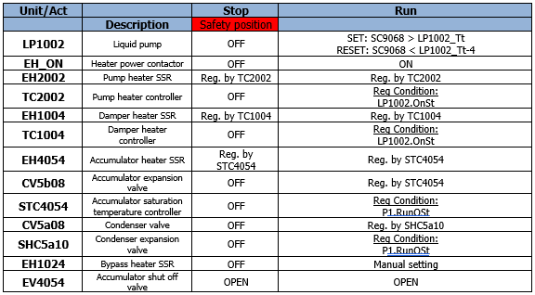
CO2 start up
No stepper for CO2 – start-up is managed with logic
Pump has a subcooling limit that must be reached before it can run
Controllers depend on pump run status or PCO run status

Slide 4
Accumulator Automatic set point
Sets the minimum allowable temperature to draw CO2 from the transfer lines
(*Default value*)
AC4054_Asp := AC4054_Usp
(*Emptying*)
IF P1.RunOSt AND LB1 Manifold emptying THEN
AC4054_Asp := MinAllowT

Slide 5
Accumulator Temperature set point
Maintains safe set point value
(*Default value*)
AC4054_Tsp := MAX(AC4054_Usp, AC4054_Asp)
(*Setpoint limits*)
IF AC4054_Tsp >= AC4054_Tsp_tH THEN
AC4054_Tsp := AC4054_Tsp_tH
ELSE IF AC4054_Tsp <= AC4054_Tsp_tL THEN
AC4054_Tsp = AC4054_Tsp_tL
END IF

Slide 6
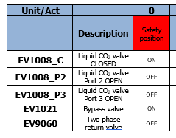
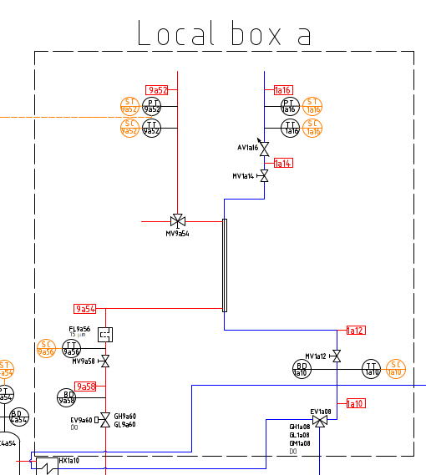
Local box
Logically EV1a08 and EV9a60 are considered as part of the local box.
There are BDs near the transfer line but it may be possible to manually trap CO2

Slide 7
Safety volume in LB
If a failure occurs the experiment valves will close when the PCO returns to the safe position
It may be better to add a safety valve or volume to the local box

Slide 8
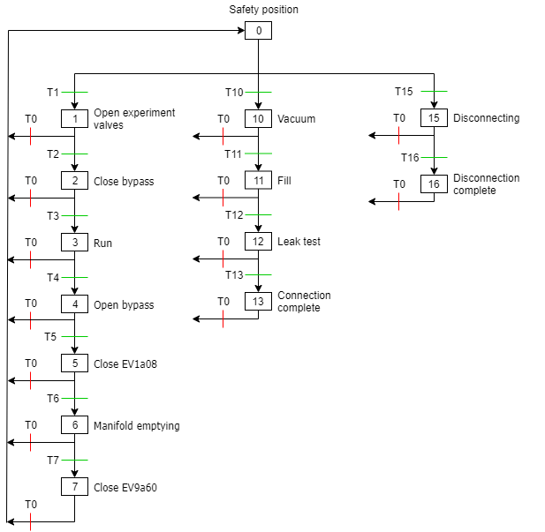
Local box stepper
The system is in bypass configuration in the safe position
The CO2 PCO and the Local box PCO can operate independently

Slide 9
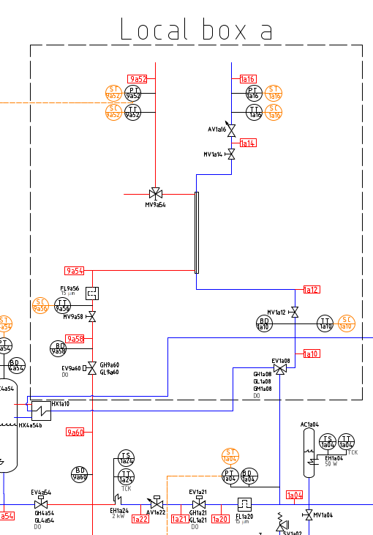
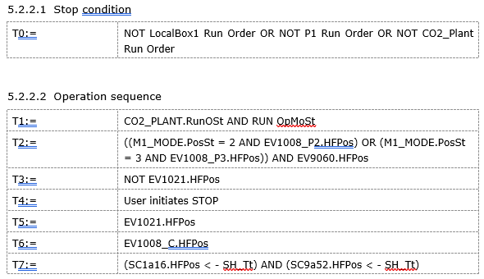
Operation stepper

Slide 10
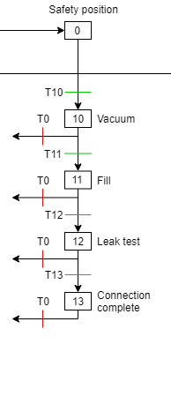
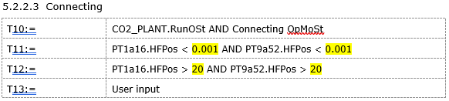
Connecting stepper

Slide 11


Disconnecting branch

Slide 12
Three-way valve control
A word parameter will be used to set the position of the valve
Logic will make sure only one is opened at a time.
In UNICOS it will be controlled by three OnOff valve objects which each control one of the output positions

Slide 13
Leak test
Local box has a calculated variable M1_Leak which calculates PT/TT so it can be monitored by the user.
The user indicates when they are satisfied with it

Slide 14
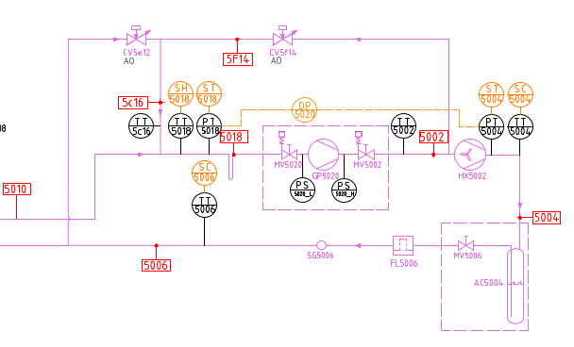
Chiller low load detection + Turbo mode
Turbo mode was not used in the MAUVE chiller
I have not included it in the FA as a result
Will it be more useful with the new refrigerant?
Do you know which refrigerant is likely to be used?

Slide 15
Interlocks
CS0c_P2_EH2b02_ACB_TS | Any heater circuit breaker tripped
CS0c_P2_EH1b04_ACB_TS | Any heater circuit breaker tripped
CS0c_P2_EH1b24_ACB_TS | Any heater circuit breaker tripped
CS0c_P2_EH4b54_ACB_TS | Any heater circuit breaker tripped
CS0c_P2_EH2b02_TS_FS | EH2b02 thermal switch tripped
CS0c_P2_EH1b04_TS_FS | EH1b04 thermal switch tripped
CS0c_P2_EH1b24_TS_FS | EH1b24 thermal switch tripped
CS0c_P2_EH4b54_TS_FS | EH4b54 thermal switch tripped
CS0c_P2_EH2b02_ATS_FS | Any heater thermal switch tripped
CS0c_P2_EH1b04_ATS_FS | Any heater thermal switch tripped
CS0c_P2_EH1b24_ATS_FS | Any heater thermal switch tripped
CS0c_P2_EH4b54_ATS_FS | Any heater thermal switch tripped
CS0c_P2_EH2b02_OT_FS | Any heater over temperature
CS0c_P2_EH1b04_OT_FS | Any heater over temperature
CS0c_P2_EH1b24_OT_FS | Any heater over temperature
CS0c_P2_EH4b54_OT_FS | Any heater over temperature
CS0c_P2_EH_B_ON_TS | EH_B power supply off
CS0c_C0_CV5e12_CEr_TS | CV5e12 carel driver error
CS0c_C0_CV5f14_CEr_TS | CV5f14 carel driver error
CS0c_Plant_FS | Plant error
CS0c_Plant_W | Plant warning
CS0c_Pump_FS | Pump error
CS0c_Pump_W | Pump warning
CS0c_C1_FS | Chiller error
CS0c_C1_W | Chiller warning
CS0c_EH_W | Heater warning
CS0c_Pres_W | Pressure warning
CS0c_Valve_FS | Valve error
CS0c_Valve_W | Valve warning
CS0c_Temp_FS | Temperature error
CS0c_Temp_W | Temperature warning
CS0c_Flow_W | Flow warning
CS0c_P0_24VDC_PS_FS | 24V DC error
CS0c_P0_24VAC_PS_FS
CS0c_C0_ChTT_IOEr_AL | Any chiller temperature sensor wire break
CS0c_C0_ChPT_IOEr_AL | Any chiller pressure sensor wire break
CS0c_C0_PS5020_HP_FS | High pressure alarm from PS5020
CS0c_C0_PS5020_LP_FS | Low pressure alarm from PS5020
CS0c_C0_GP5020_CB_FS | Compressor circuit breaker tripped
CS0c_C0_HX5002_CB_TS | Condenser fan circubt breaker tripped
CS0c_P0_24VDC_CB_FS | 24VDC circuit breaker trip
CS0c_P0_24VAC_CB_FS | 24VAC transformer circuit breaker trip
CS0c_P0_Misc_CB_FS | Cabinet equipment circuit breaker trip
CS0c_P1_TT_IOEr_AL | left temperature sensor wire break
CS0c_P1_PT_IOEr_AL | Left pressure sensor wire break
CS0c_P1_LP1a02_CB_TS | LP1a02 circuit breaker tripped
CS0c_P1_LP1a02_mP_FS | LP1a02 membrane pressure too high
CS0c_P1_12QA2_TS | P1 heater circuit breaker tripped
CS0c_P1_EH2a02_ACB_TS | Any heater circuit breaker tripped
CS0c_P1_EH1a04_ACB_TS | Any heater circuit breaker tripped
CS0c_P1_EH1a24_ACB_TS | Any heater circuit breaker tripped
CS0c_P1_EH4a54_ACB_TS | Any heater circuit breaker tripped
CS0c_P1_EH2a02_TS_FS | EH2a02 thermal switch tripped
CS0c_P1_EH1a04_TS_FS | EH1a04 thermal switch tripped
CS0c_P1_EH1a24_TS_FS | EH1a24 thermal switch tripped
CS0c_P1_EH4a54_TS_FS | EH4a54 thermal switch tripped
CS0c_P1_EH2a02_ATS_FS | Any heater thermal switch tripped
CS0c_P1_EH1a04_ATS_FS | Any heater thermal switch tripped
CS0c_P1_EH1a24_ATS_FS | Any heater thermal switch tripped
CS0c_P1_EH4a54_ATS_FS | Any heater thermal switch tripped
CS0c_P1_EH2a02_OT_FS | Any heater over temperature
CS0c_P1_EH1a04_OT_FS | Any heater over temperature
CS0c_P1_EH1a24_OT_FS | Any heater over temperature
CS0c_P1_EH4a54_OT_FS | Any heater over temperature
CS0c_P1_EH_A_ON_TS | EH_A power supply off
CS0c_P2_TT_IOEr_AL | Right temperature sensor wire break
CS0c_P2_PT_IOEr_AL | Right pressure sensor wire break
CS0c_P2_LP1b02_CB_TS | LP1b02 circuit breaker tripped
CS0c_P2_LP1b02_mP_FS | LP1b02 membrane pressure too high
CS0c_P2_13QA2_TS | P2 heater circuit breaker tripped

Slide 16
Interlocks
CS0c_P1_Ptmax_AL | Any pressure A high
CS0c_P1_LP1a02_DP_AL | Differential pressure over LP1a02
CS0c_P1_LP1a02_HP_FS | LP1a02 discharge pressure too high
CS0c_P1_LP1a02_SC_AL | LP1a02 subcoolong too low
CS0c_P1_LP1a02_nFL_FS | LP1a02 no flow full stop
CS0c_P1_EH2a02_HT_TS | EH2a02 temperature high
CS0c_P1_EH1a04_HT_TS | EH1a04 temperature high
CS0c_P1_EH1a24_HT_TS | EH1a24 temperautre high
CS0c_P1_EH4a54_HT_TS | EH4a54 temperature high
CS0c_P1_EH4a54_HP_TS | EH4a54 interlocked due to AC4a54 high pressure
CS0c_P2_Ptmax_AL | Any pressure B high
CS0c_P2_LP1b02_DP_AL | Differential pressure over LP1b02
CS0c_P2_LP1b02_HP_FS | LP1b02 discharge pressure too high
CS0c_P2_LP1b02_SC_AL | LP1b02 subcoolong too low
CS0c_P2_LP1b02_nFL_FS | LP1b02 no flow full stop
CS0c_P2_EH2b02_HT_TS | EH2b02 temperature high
CS0c_P2_EH1b04_HT_TS | EH1b04 temperature high
CS0c_P2_EH1b24_HT_TS | EH1b24 temperautre high
CS0c_P2_EH4b54_HT_TS | EH4b54 temperature high
CS0c_P2_EH4b54_HP_TS | EH4b54 interlocked due to AC4b54 high pressure
CS0c_C0_GP5020_HP_FS | GP5020 discharge pressure high
CS0c_C0_GP5020_LP_FS | GP5020 suction pressure too low
CS0c_C0_SH5018_FS | Suction superheating too low
CS0c_C0_TT5018_FS | Suction temperature
CS0c_P1_TT9a68_TS | CO2 A temperature too low
CS0c_P2_TT9b68_TS | CO2 B temperature too low
CS0c_C0_TT5004_AL | Condensation temperature too high
CS0c_C0_ST5a10_TS | A accumulator evaporation temperature low
CS0c_C0_ST5b10_TS | A condensor evaporation temperature low
CS0c_C0_ST5c10_TS | B accumulator evaporation temperature low
CS0c_C0_ST5d10_TS | B condensor evaporation temperature low
CS0c_C0_GP5020_HT_FS | Discharge temperature high
CS0c_C0_SC5004_AL | Subcooling low after the condensor
CS0c_C0_GP5020_ONF_FS | Chiller start stop limit exceeded

Slide 17
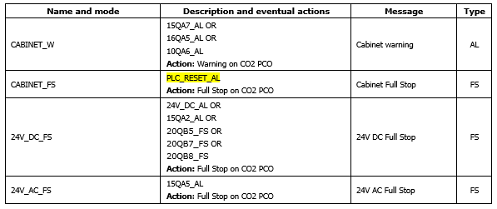
Alarm groups – Common

Slide 18
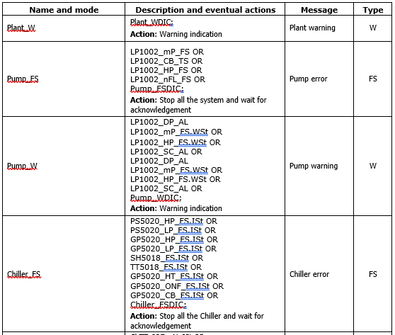
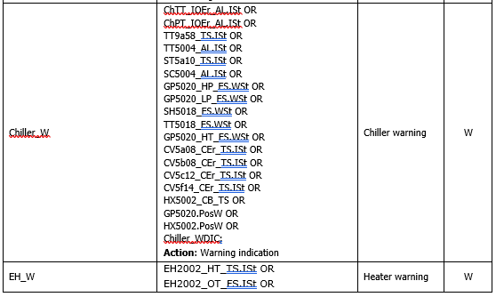
Alarm groups

Slide 19
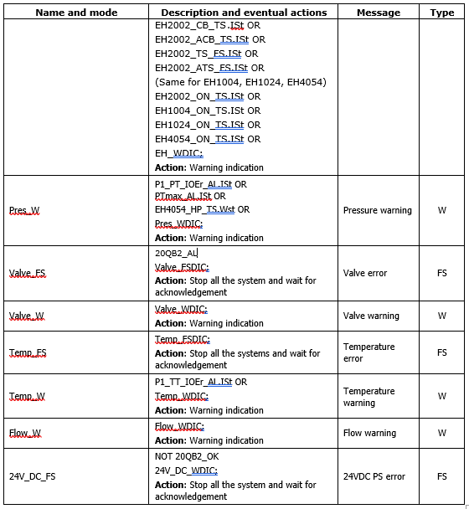
Alarm groups

